Slide 1
DHCP (Dynamic Host Configuration Protocol)
By: Joe O Here

Slide 2
IP addressing made easy
What does DHCP do?
Automatic learning of ip addresses, subnet masks, default gateways, DNS server
Essential in modern networks
Used with Client devices
Routers and switches manually configured
Small networks- router is DHCP server
Large networks- windows/Linux server
DHCP servers use UDP 67
DHCP clients use UDP 68
Ipconfig /all
Shows if dhcp is enabled
Ipconfig /release
Clients give up lease or ip addresses early
Ipconfig /renew
Renegotiate IP address lease

Slide 3
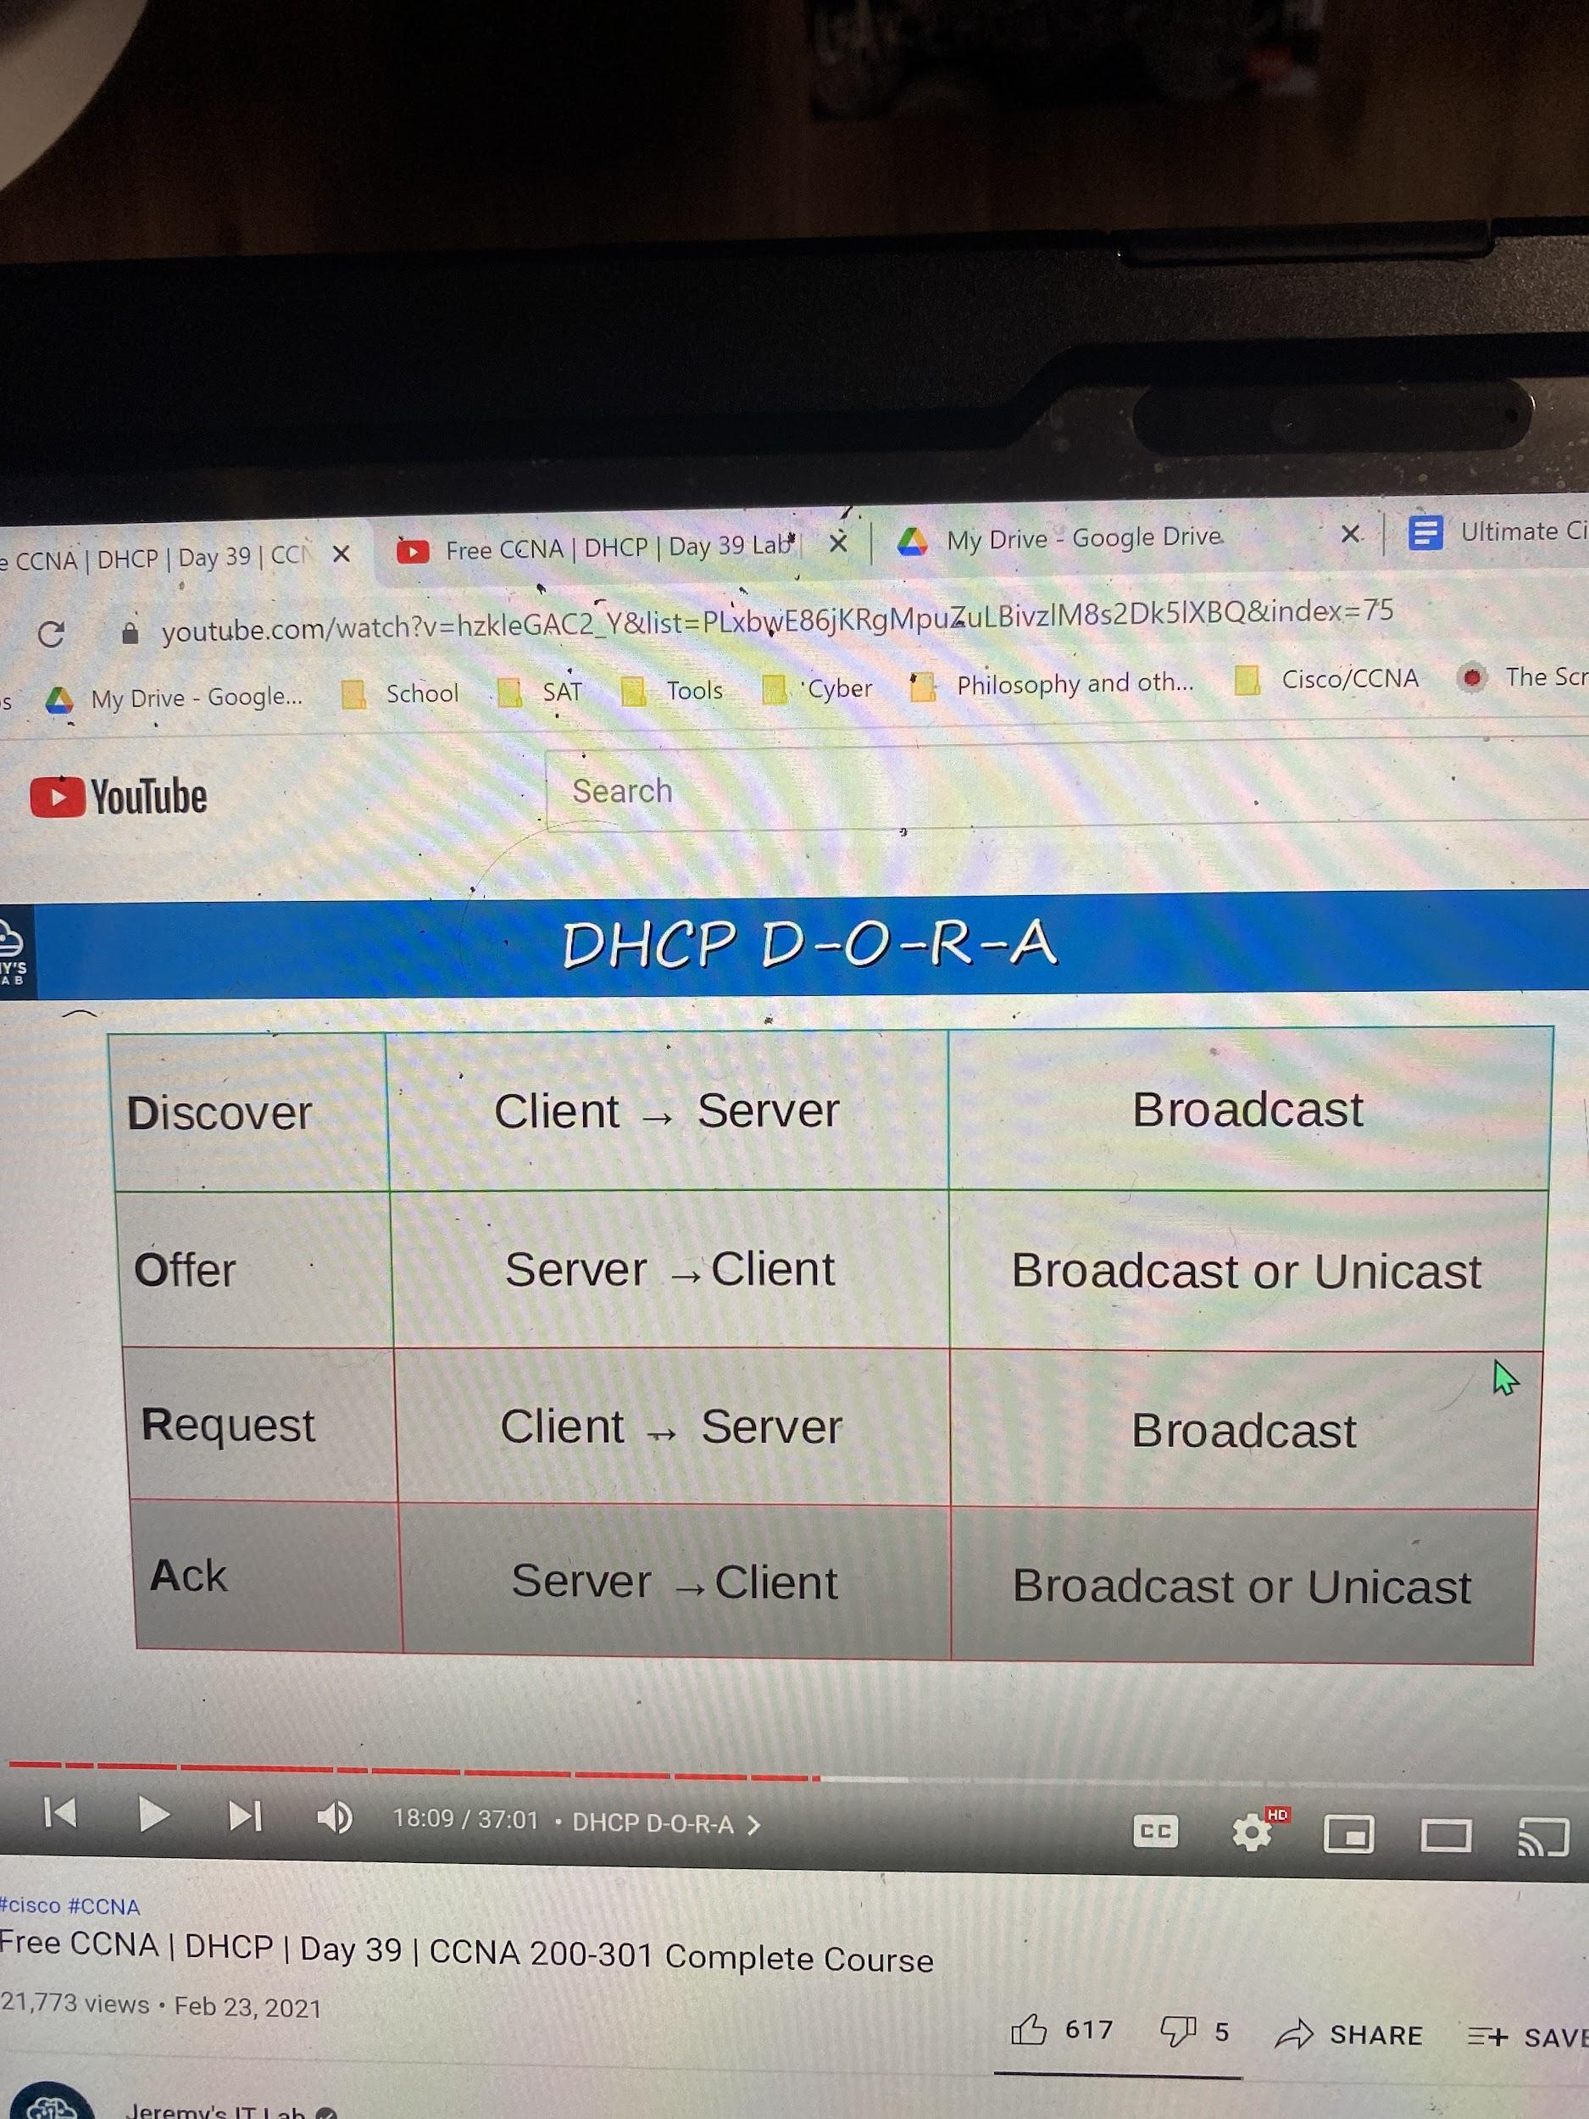
How does DHCP Work?
DHCP discover - (broadcast addresses) finding dhcp servers, I need an ip address
DHCP offer - here is an IP address, message from server to client, message can be sent unicast or broadcast
DHCP request - I want to use the IP address you offered me,
DHCP ack - okay you can use it bro

Slide 4
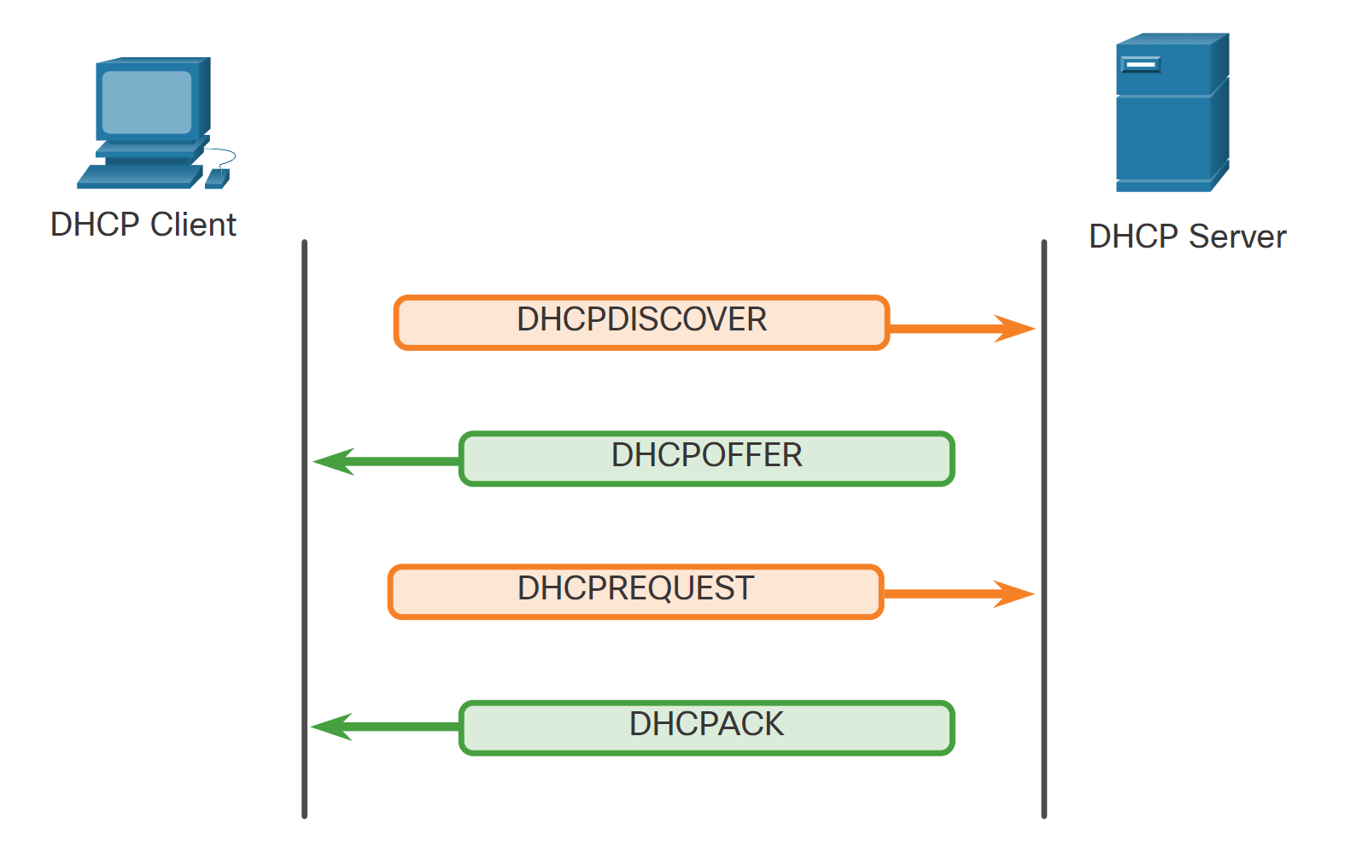

Slide 5
DHCP Relay
DHCP clients exist in the subnet
DHCP servers do not exist in the subnet
broadcast doesn’t leave local subnet, therefore you need a relay agent
DHCP Relay Agent Configuration
Interface {interface} (interface that faces local)
Ip helper-address A.B.C.D (usually address of server)
(Make sure R1 has a route to the server, static or dynamic works)
Do show ip int {interface} (verify helper address)

Slide 6
DHCP Server Configuration
You typically need to exclude static addresses in the network that are being used for routers and switches
ip dhcp exclude-address (addresses you don’t want to use)
Configuring a Server:
Ip dhcp pool {pool name}
network [network-address] [subnet-mask]
default-router [default-gateway]
dns-server [dns-address]
domain-name [example.com]
Lease {days} {hours} {minutes} or {infinite}
Show ip dhcp binding (shows all dhcp clients with addresses)

Slide 7
DHCP Client Configuration
(for intermediary devices)
In most cases you would want to statically assign ip addresses to switches and routers for easier identification in networking and remote management.
Configuration:
Interface {interface}
ip address dhcp
Verify:
Do show ip int {interface}

